Slide 1




EL/Civics Online
A FREE professional development opportunity for teachers and volunteers
www.elcivicsonline.org
Notes:
EL/Civics Online is designed to encourage and prepare teachers to integrate English language learning and civics content. EL/Civics Online is free, requiring only a brief registration.

Slide 2
EL/Civics Online Sponsors
U.S. Department of Education/Office of Vocational and Adult Education
&
U.S. Citizenship and Immigration Services/Office of Citizenship
Adult Learning Resource Center
Center for Applied Linguistics
Notes:
EL/Civics Online meets the definition of EL/Civics education as defined by the Office of Vocational and Adult Education.

Slide 3
What is EL/Civics?
Regular ESL Class
Learn English
Notes:
EL/Civics instruction is different from regular ESL instruction. In a regular ESL class, the goal is to learn English.

Slide 4
What is EL/Civics?
EL/Civics Class
Learn English
Learn About the United States
+
Notes:
In an EL/Civics class, there are two equal goals: students learn English and about the United States at the same time.

Slide 5

What is EL/Civics Online?
A unique professional development course for instructors and volunteers who wish to incorporate EL/Civics into adult ESL, EL/Civics, and Citizenship classes.
This means that this course is for:
ESL Teachers
• EL/Civics Teachers
• Citizenship Teachers
• Tutors
• Volunteers
Notes:
Teachers as well as tutors and volunteers can benefit from EL/Civics Online. They will learn useful and innovative techniques for presenting civics content whether in general ESL classrooms, EL/Civics courses, or Citizenship preparation classes.

Slide 6
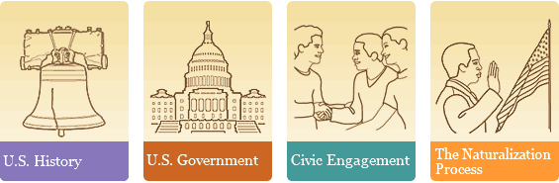
Components of EL/Civics Online
There are four courses …
And two tutorials …
• Lesson Planning • Adapting Materials
Notes:
Participants begin EL/Civics Online with a brief review of ESL Foundations. After that participants may choose any of the four courses listed above. They may complete just one, or they may be inspired to take all four.
The Lesson Planning tutorial is a required component of the first course a participant takes. The Adapting Materials tutorial is available by choice for those participants who want to use authentic materials but need to make them accessible to learners with limited English vocabularies and grammar knowledge.

Slide 7
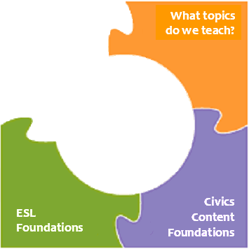
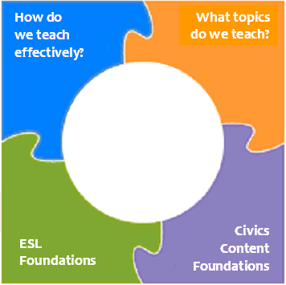
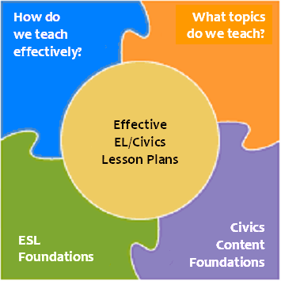
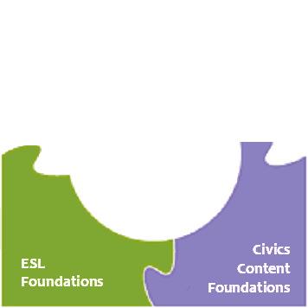
Course Structure
- Activate and develop
students’ existing
knowledge about the
content area
Use visuals and provide
concrete examples
- Use critical thinking to
examine the
topic
- Decide what topics
in the content area are
most relevant and
important to students
- Present those topics
in a meaningful and
understandable way
- Incorporate student’s
background
- Develop English fluency
- Build conceptual
understanding
- Strengthen four skills
- Discover the
important, underlying
elements of each
content area based on
accepted standards
Notes:
(Note: Practice clicking through this slide in “Slide Show View” in order be familiar with the notes for each piece of the puzzle.)
This slide shows the structure of each of the four courses in EL/Civics Online. Each course combines ESL foundations with foundations specific to the course, whether it is U.S. History, U.S. Government, Civic Engagement, or the Naturalization Process.
Participants first learn what concepts to teach and then how to teach them. In the lesson planning examples, all the parts of the course come together. In each EL/Civics Online course, participants see lesson plan examples at a variety of levels and then create their own.

Slide 8
What are the benefits of using EL/Civics Online?
It’s Fun!
Quality professional development
available at your convenience
Ready-to-use lesson plans,
handouts, and illustrations
A personalized information center
containing all of the materials from
each course you have taken
It’s Free!
Notes:
The courses give teachers and tutors quality online professional development allowing them to learn or refresh their teaching skills. Best of all, it’s fun and it’s free!
(Note: The following 5 slides show the features of the personalized information center.)

Slide 9
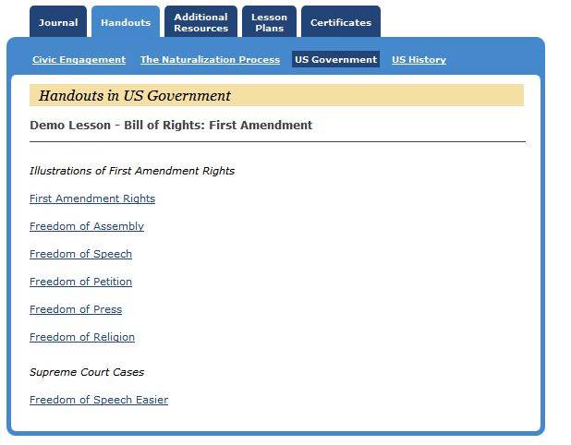
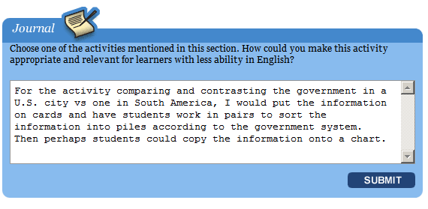
Personalized Information Center
All your Journal Entries in one place!
Notes:
Journal discussion. Add your own notes here.

Slide 10
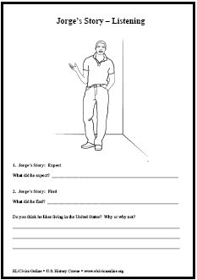
Personalized Information Center
Handouts from each course!
Notes:
Personalized Information Center discussion. Add your own notes here.

Slide 11
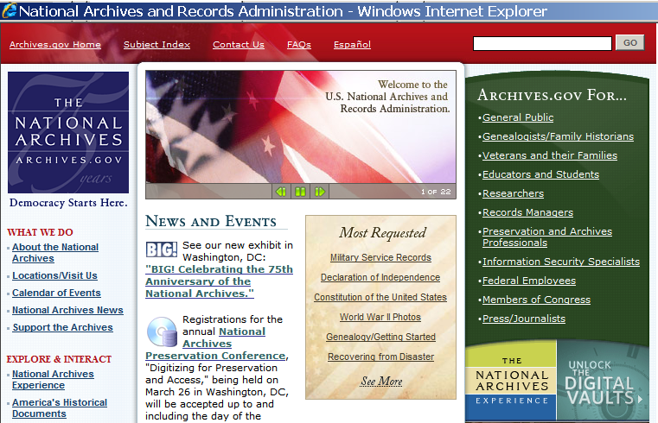
Personalized Information Center
Additional Resources from each course!
Notes:
Resources discussion. Add your own notes here.

Slide 12
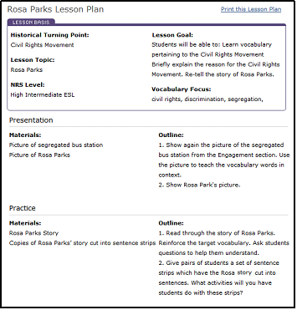
Personalized Information Center
All the Lesson Plans you’ve made!
Notes:
Customized lesson plans discussion. Add your own notes here.

Slide 13
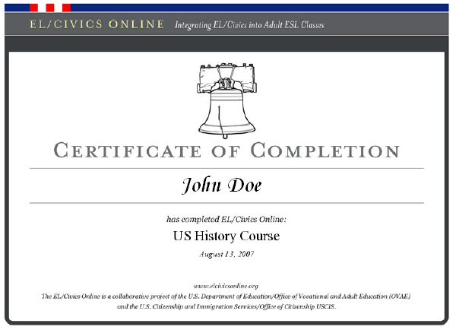
Personalized Information Center
Your Certificates of Completion!
Notes:
Certificate of Completion discussion. Add your own notes here.

Slide 14
Don’t miss this unique opportunity to expand and enhance your EL/Civics teaching ability!
www.elcivicsonline.org
Notes:
Note: In addition to this PowerPoint, a Master Teacher can duplicate and distribute EL/Civics Online flyers and bookmarks by following the link in the Master Teacher course.
If an Internet connection is available:
After this PowerPoint, the Master Teacher may want to show the Welcome Page of EL/Civics Online, the Learn More section, and/or a few webpages from one of the four courses.

